Slide 1
T-JAV-501 Kick-Off
Pré-MSc Pro

Slide 2
Objectives
Starting from the boostrap as a first building block …
… and what you learnt from the T-JAV-500 pool ...
You make an Object-Oriented 2D Game in Java
2 weeks, by groups of 2 or 3 people
As long as it’s in Java and OOP-friendly and validated by your pedago, go in any direction you want
The goal is to put OOP principles into practice, not to make a game for the sake of making a game
Don’t be scared : if you don’t like a direction, take another direction.
FIRST, read all the document, THEN craft your idea, and ask for validation

Slide 3
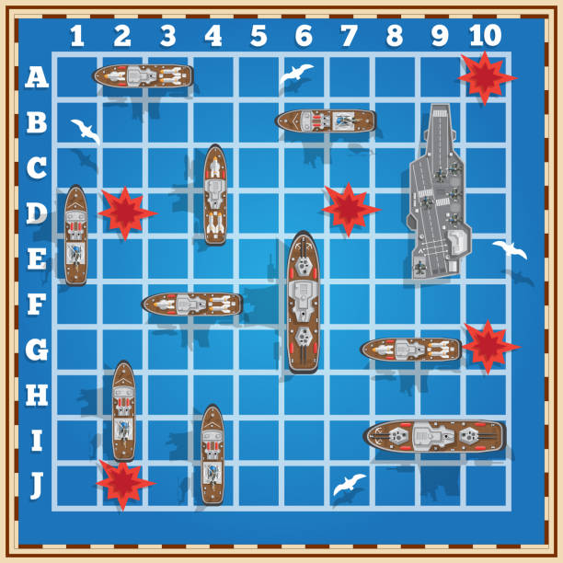
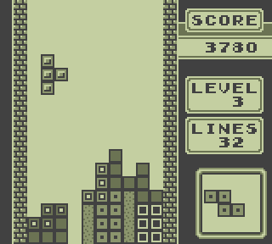
Objectives
If you do this… it should be enough to succeed the project
If you want to do more… stay tuned !

Slide 4

Combat System
The very core of many games is their combat system and resolution algorithm
RPGs : depends on characters stats, skills, items, spells, dice rolls...
Wargames : depends on unit stats, terrain, weather, ballistics…
Fighting games : depends on attack types, collisions…

Slide 5
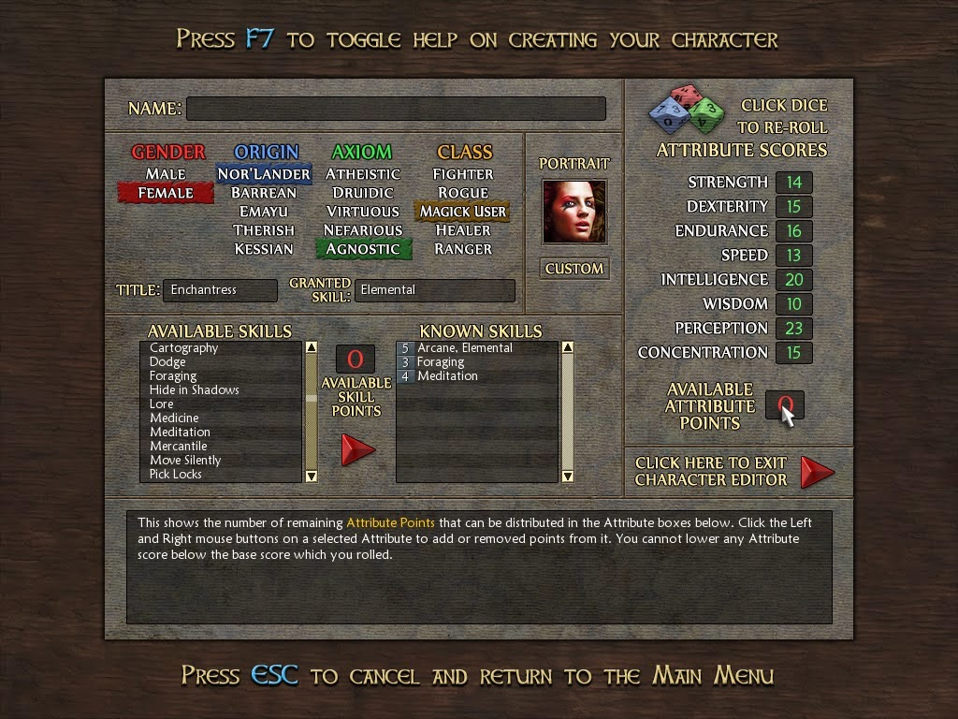
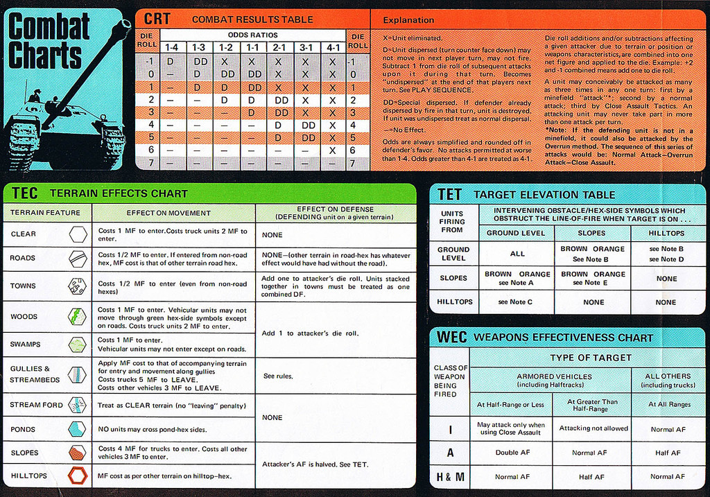
Combat System

Slide 6
Party Management
By definition, strategy games require to manage an army
Many role-playing game leave you in charge of a whole party (4 to 6 characters)
They can be hired and fired
They can have their own personality
They may clash between themselves

Slide 7
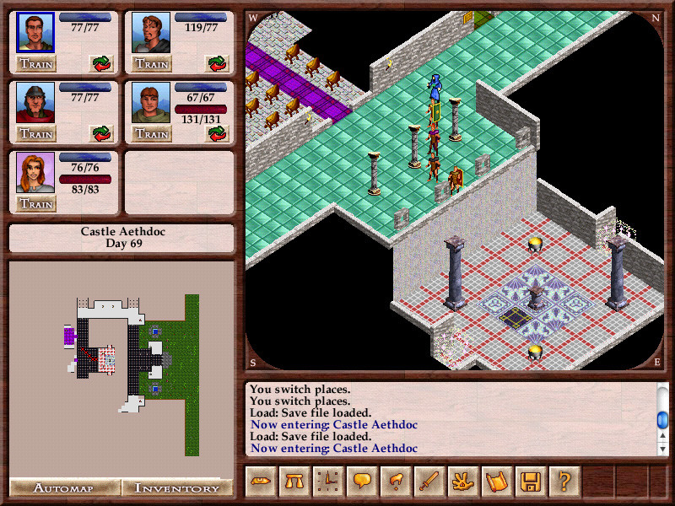
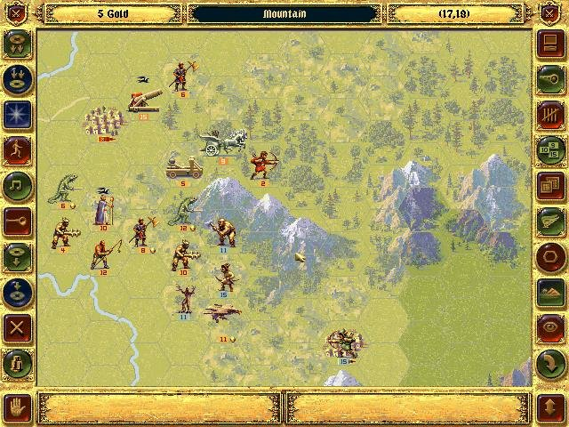
Party Management

Slide 8
Interaction with items and characters
You can talk to NPCs instead of just fighting them
You can also try to avoid them
You can store items, use them on the environment, and even use them between themselves
Puzzles can be solved with dialogue choices and item combinations

Slide 9
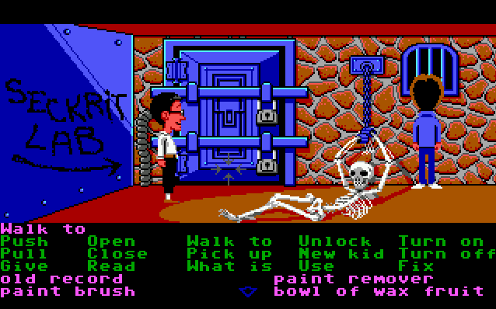
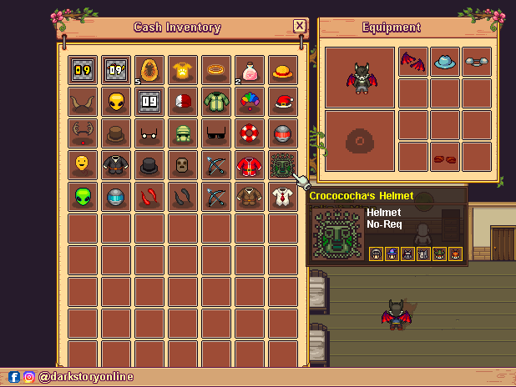
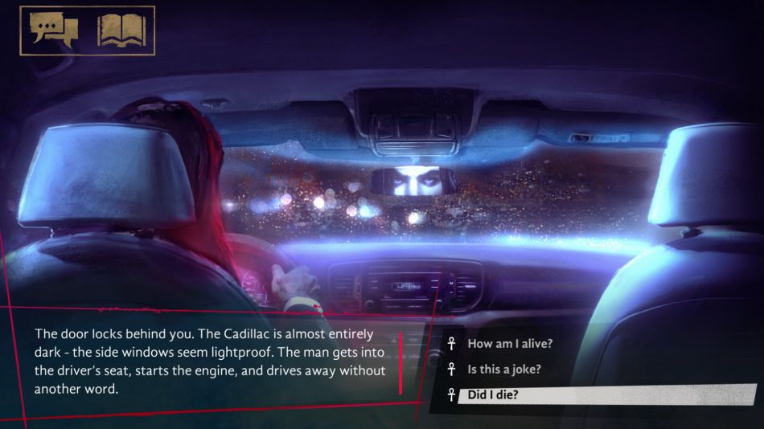
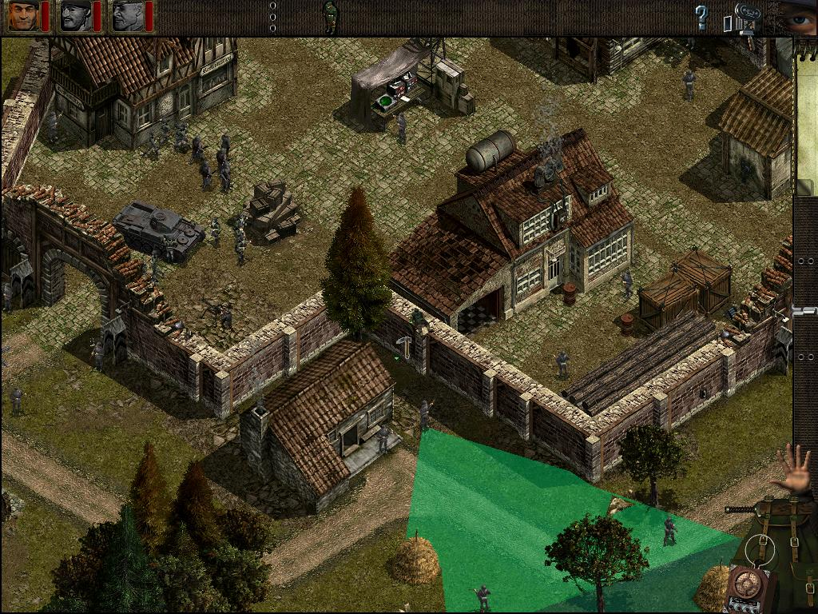

Interaction with items and characters

Slide 10
Character behavior and pathfinding
NPCs don’t have to be static
They can wander or patrol
They can chase you if they see you
They can have a life of their own
They may have a path to find
That path can depend on many parameters
Obstacles
Target distance
...

Slide 11
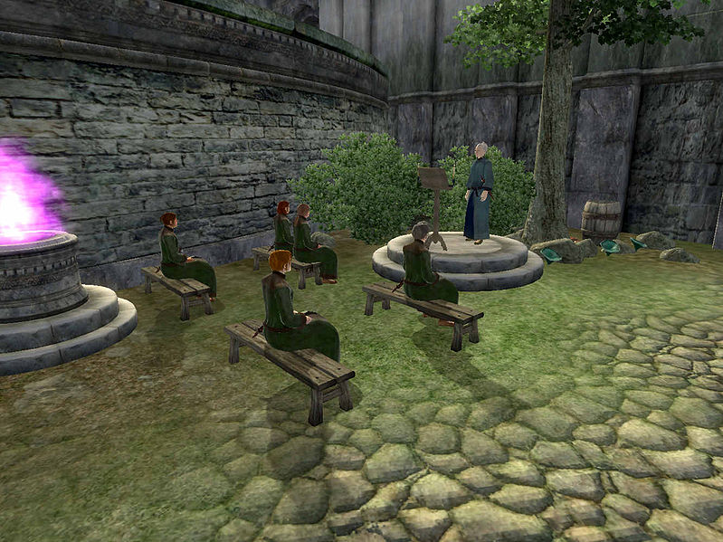
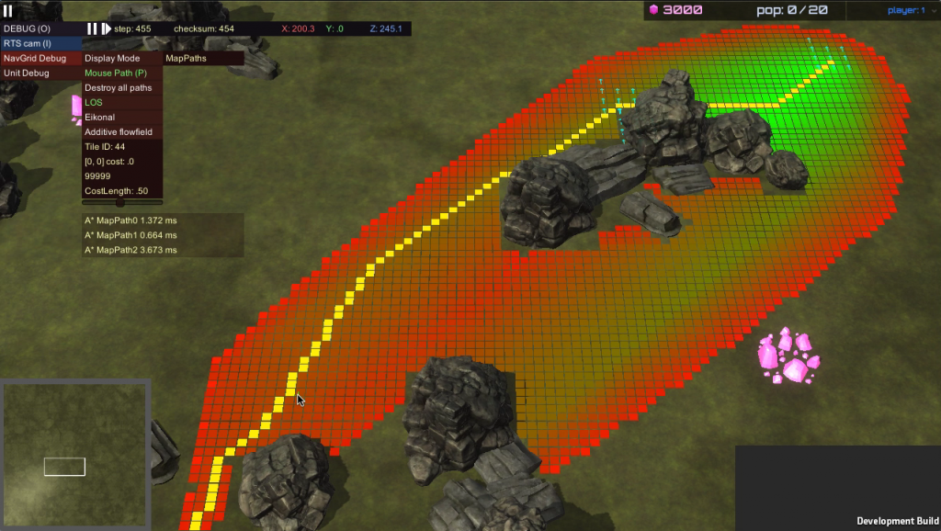
Character behavior and pathfinding

Slide 12
Level Generation
Cells can have obstacles (walls, doors, trees...)
They can form a level, a dungeon, a maze, an exterior…
They can be randomly generated

Slide 13

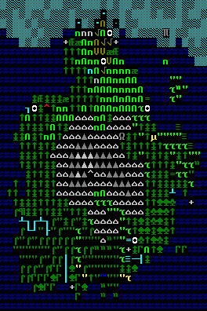
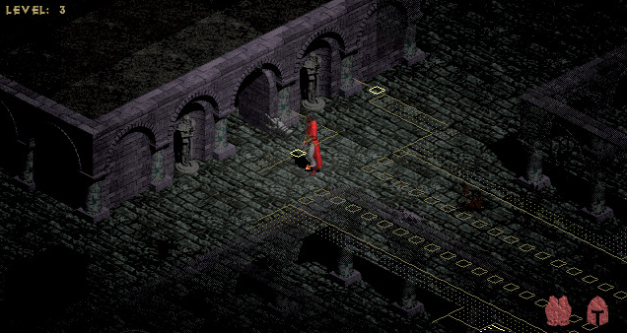
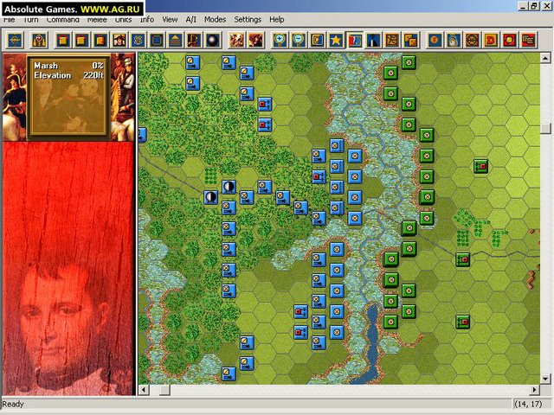
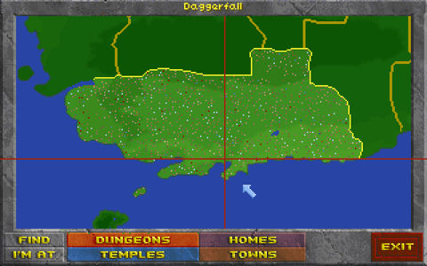
Level Generation

Slide 14
Passive Management
In many management games, you just train the character(s), you are not the character(s)
You can train an AI to solve a game (a maze, a strategy game, etc.)

Slide 15
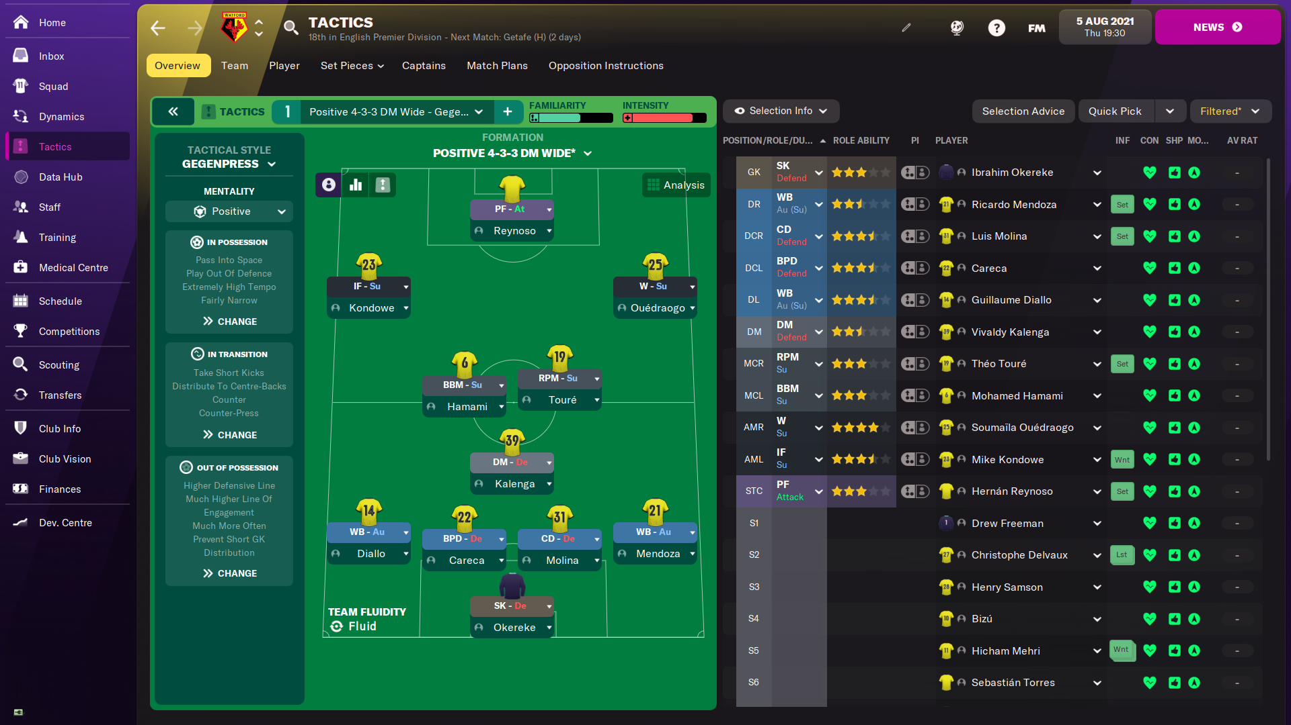

Passive Management

Slide 16
Real (?) time
Your game can be a turn-by-turn strategy game or RPG
If turns last a couple of milliseconds, it can look like a real-time game

Slide 17
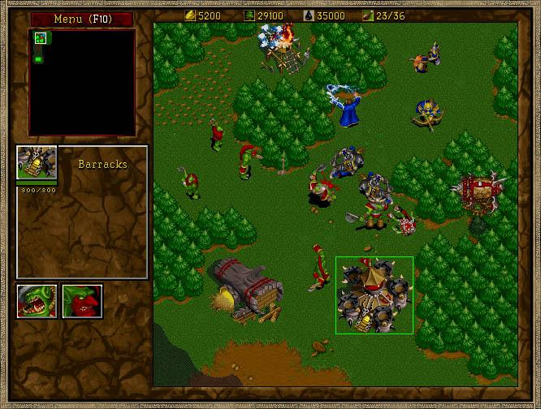
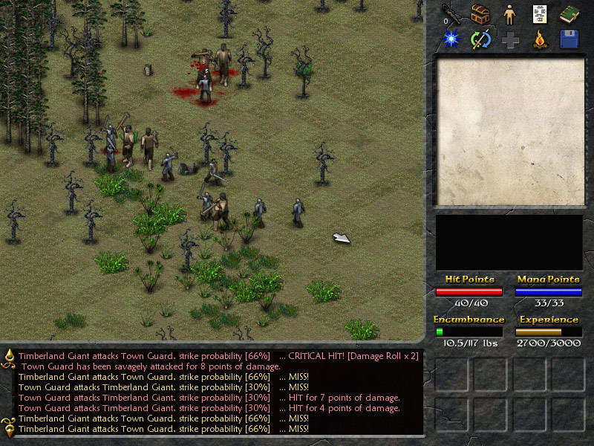
Real (?) time

Slide 18
Input and Character Control
Many aforementioned game genres use mouse (with or without keyboards)
Point’n’click games (the name speaks for itself)
Strategy games
Some role-playing games
You can also include shooters and platformers

Slide 19
Last instructions
Which direction ?
Focus on one single direction and exploit it to the maximum
OR
Take several aspects and mix them into a whole gameplay
Graphics ?
Whatever you want (JavaFX, ASCII Art, etc...)
Not the most important
Object-Oriented !!!
THAT’S the most important !

Slide 20
There’s so much more, but...
Don’t forget to make it right
You can focus on one single direction and exploit it to the maximum
You can also take several aspects and mix them into a whole gameplay
We gave you examples of directions, but you can bring some of your own
Don’t forget to make it right...ly oriented (object-oriented)
Two weeks focusing on networking ? Nope, that’s not what we asked for !
It’s not about making a game for the sake of making a game, or learning game making per se
It’s about learning OOP principles by making a game
Don’t forget to have fun !

Slide 21
What about the graphics ?
You’re free to choose whatever you want
Java FX, or at least AWT / Swing, is the first choice
ASCII art can be beautiful
Text-based game with a deep gameplay will do
...
… as long as you have something to play
It’s not about wasting 2 weeks trying to build a beautiful but empty shell
… as long as you have something Object-Oriented to play
Have we said it enough ?

Slide 22
Thank you for your attention
Before we start… any questions ?

